Slide 1
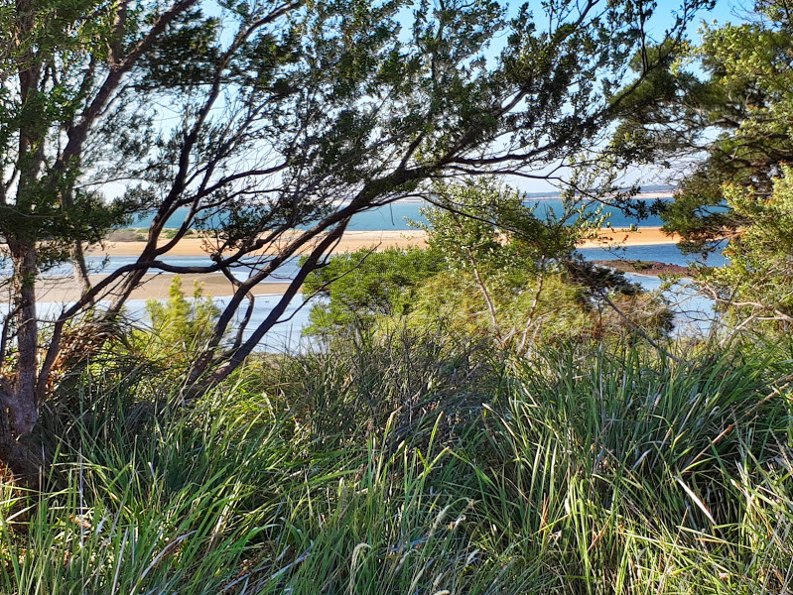
Warn-marin
(Westernport)
WPPC AGM feb 2021
gidja walker

Slide 2
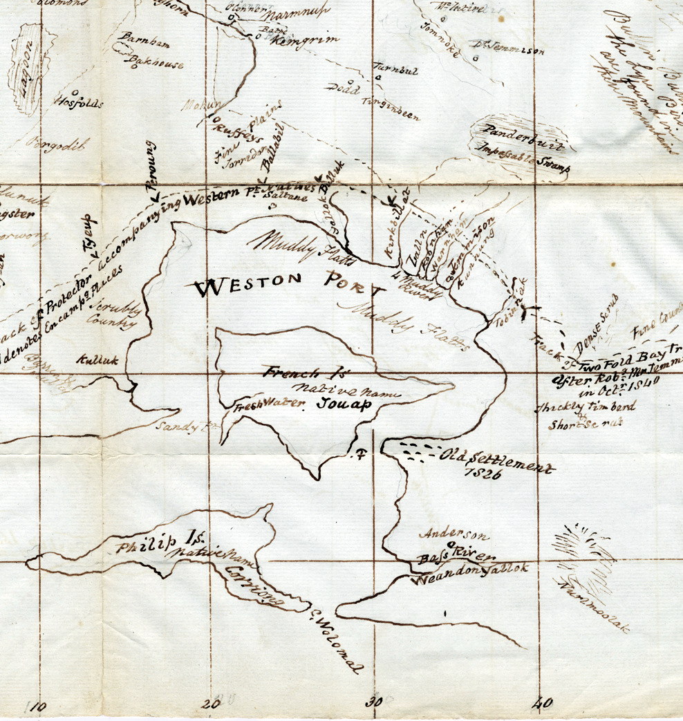
Acknowledgement of country
Notes:
I’d like to pay respects to the Bunurong and our Wurundjeri neighbours to the north on whose land and waters Warn-Marin catchment includes. And to there elders past and present who never ceded sovereignty

Slide 3
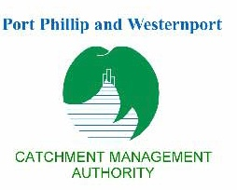
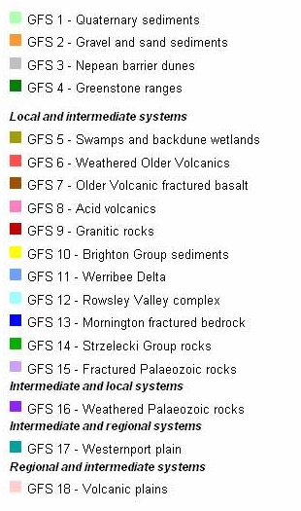
Notes:
It’s useful when trying to understand an ecosystem to look back at the past to the underlying processes that have produced what we see today. This map is from a groundwater flow system report but serves to illustrate this.
480 million years ago this part of the southern coastline was under the sea with sediments of even older rocks settling on the sea floor. These elements were elevated and eroded producing the skeleton of the mornington peninsula.
300 million years ago molten magma intruded from below into these paleozoic sediments and cooled kms below the surface to form the granitic rocks that are now exposed around the edge of the Warn-Marin catchment
150 million years ago as australia and antartica began to separate parts of the area were submerged under a fresh water lake which led to the Jurassic shales and sandstones along with fossils and wood being deposited. The stress of the this continental separation, with its folding, faulting and uplifting produced the strezlecki ranges.
100 million years ago volcanoes produced extensive lave flows filling gullies and producing the rich red soils of Red Hill and Millowl (Phillip Island)…..the land continued to erode until during the Tertiary 60 million years ago Bass strait was largely dry with flood plains , lakes and peat swamps. The marybinong, yarra, and werribee rivers joined up with the Tarwin river and flowed into a big. The Tamar river also flowed into this swamp which emptied into the sea to the southwest. Sea levels fluctuated widely and significant movement along faultlines resulted in the formation of the Nerm (Port Phillip) and Warn-Marin sunklands.

Slide 4
Notes:
This drowned the ancient drainage system of the Tarago river. Since then the islands within that drainage system have been inundated by sand bars and large areas of alluvium have been deposited. Sea levels continued to fluctuate and erosion continued. The bunurong could walk back and forth and trade with the Palawa in Lutruwita (Tasmania). Then 10-12,000 years ago the land bridge flooded and the sea rose and fell, then rose to 2m above current levels before it subsided. All of this has produced a diversity of habitats and ecosystems all of which interconnect. The post colonisation period has seen a lot of that destroyed

Slide 5
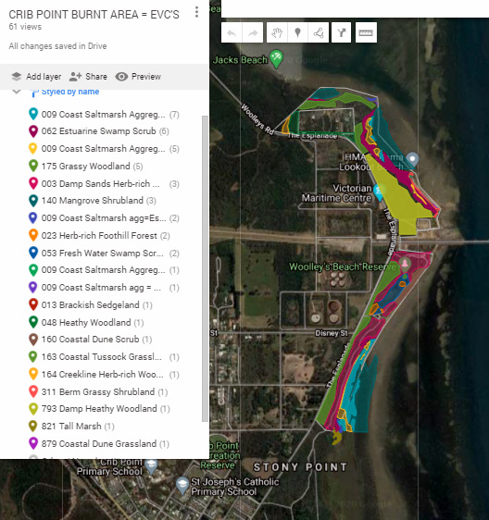
Terrestrial biodiversity
Distribution of EVC’s relates to the soils
Most biodiversity is concentrated where ecosystems overlap or join
Much of it is microscopic and difficult to measure

Slide 6
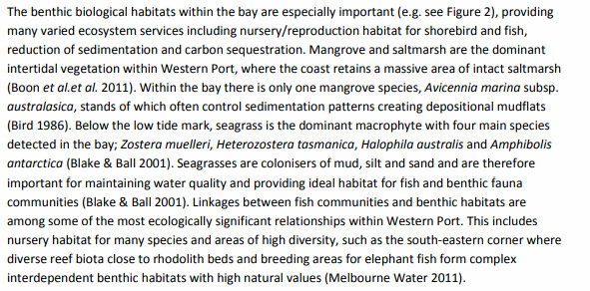
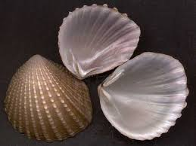
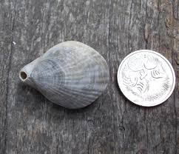
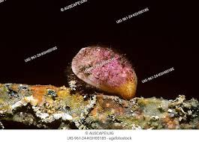
Notes:
Brooch shell (Neotrigonia margaritacea) and Lamp Shell (Magellania flavescens) or brachiopods . The ancient forms of brachiopods arose in the Cambrian Period (490 to 545 million years ago).

Slide 7
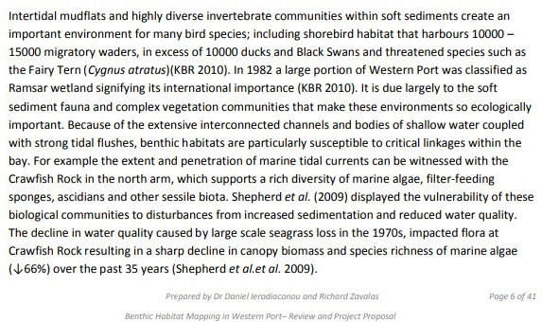
and mud flats

Slide 8
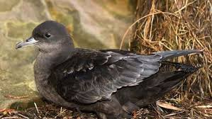
This interconnectedness extends beyond the catchment of warn-marin
Short tailed shearwaters nesting on the westernport islands travel the world in their seasonal migration to the bering straits and then often to antartica when they return
The water and currents connect with bass strait and beyond, for the whales and fish that migrate

Slide 9
Issues, opportunities & challenges
Notes:
There are many impacts currently operating on Warn-Marin and it’s catchment. The battle with the pipeline and floating gas facility. The bandicoots trying to survive in a shrinking area relying on blackberries and kikuyu. Pressure on some of the last remnants around the sand mines and holden proving grounds. The defence land would be perfect transferred into a national Park….(next slide)

Slide 10
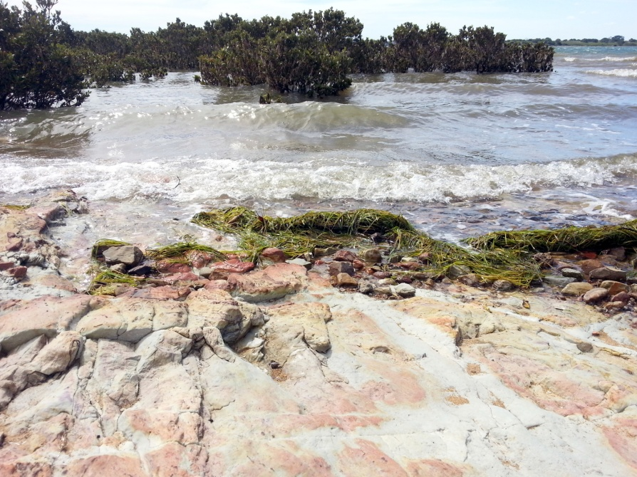
Waterways, creeklines estuaries, saltmarsh, & mangroves protection from pollutants and nutrients etc but also most likely to be impacted by sea-level induced climate change

Slide 11
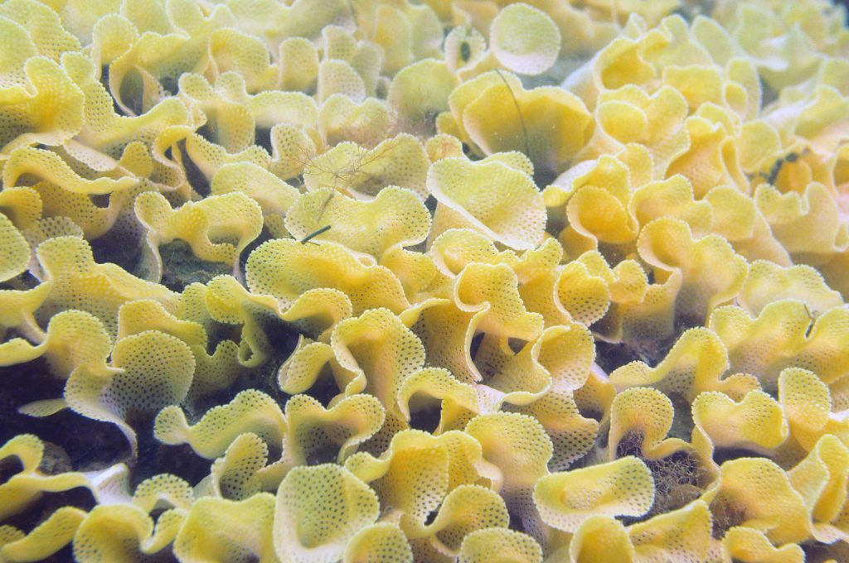
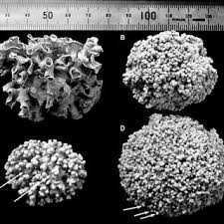
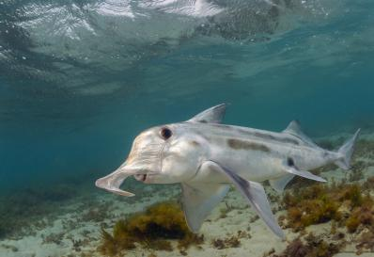
rhodoliths, elephant fish & bryozoan reefs
Notes:
Main thing to get across is how unique and special Warn-Marin is

